Slide 1
MPG
PC-Lint
File System

Slide 2
Housekeeping
Attendance
Next weeks:
Radio? (ANT)
Scheduling Conflict?
End Project

Slide 3
What is PC-Lint?
Static Source Code Analysis software…
Essentially a compiler on steroids
“It will thoroughly check your C/C++ source code for bugs, glitches, inconsistencies, non-portable constructs, and much more, so you can find and fix your bugs more quickly, and more economically, than with traditional debugging procedures.”

Slide 4
PC-Lint vs Compiler?
Compiler | PC-Lint
Syntax errors | Syntax errors
Type mismatch | Type mismatch + unintended casts
 | Looks at ranges of numbers (value tracking)
 | Enforces coding conventions
 | Checks portability
 | Warnings / common pitfalls
 | Order of Operations
 | Names hiding other names
 | exposing privileged data
 | const optimization
 | uninitialized variables
 | etc…

Slide 5
PC-Lint Example #1
#include <stdio.h>
int main()
{
int i;
int a[] = {1,2,3};
int n = sizeof(a)/sizeof(int);
for(i=0;i<=n;i++)
printf("a[%d]=%d\n",i,a[i]);
return 0;
}
offbyone.c 9 Warning 661: Possible access of out-of-bounds pointer
(1 beyond end of data) by operator '[' [Reference: file offbyone.c: lines 7, 8, 9]

Slide 6
PC-Lint Example #2
int f( int n )
{ return 10/n; }
int g( int n )
{
if( n == -1 ) return 0;
return f(n) + g( n - 1 );
}
int main()
{ return g( 3 ); }
During Specific Walk: multipass.c 16 g(3) #2 multipass.c 11 g(2) #3 multipass.c 11 g(1) #4 multipass.c 11 g(0) #5 multipass.c 11 f(0) #5 multipass.c 5 Warning 414: Possible division by 0 [Reference: file multipass.c: lines 11, 16]

Slide 7
PC-Lint and MPG
{svn folder}/project/makeout/make.exe
Builds the entire project according to a “makefile”
The makefile is essentially a script that will build your program for you however you want… (it’s set up to be very similar to IAR)
IAR is intended for debugging… the makefile provides a consistent build every time… and also allows you to add extra tools

Slide 8
Try running it… what do you see?
{svn folder}/project/makeout/make.exe
Compiling / linting each file…
Linking
Converting .out to .hex
Linting project
Compiling / linting… Linking UnitTests
Running Unit Tests
How to fix the PC-Lint warnings?

Slide 9
Adding files to the project
{svn folder}/project/makeout/makeInclude.mk
SRC = beeper.c \
button.c \
{spaces} bsp.c \
{not tab} circularBuffer.c \
…
And drag/drop the file into IAR

Slide 10
Questions?

Slide 11
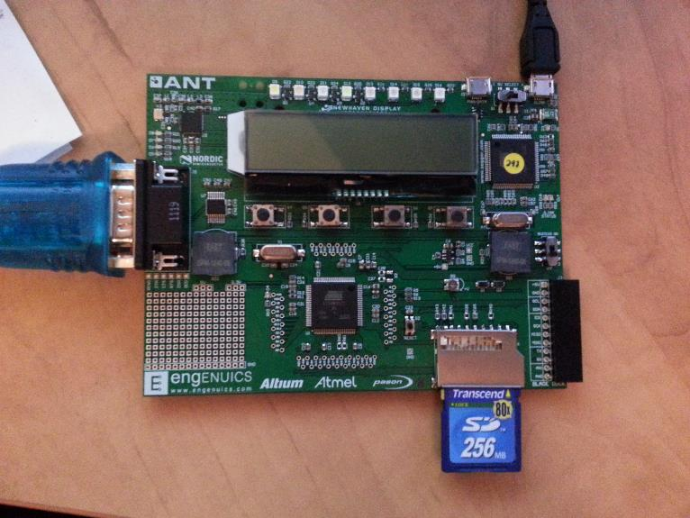
File Systems

Slide 12
File Systems
Peripheral
Purpose
GPIO
Setup pins, card detect
SPI driver
controls serial data transfers
SD Card
driver
Provides card commands and responses
(store
data, read data, card size/type, etc.)
File System
Organizes
the memory into a useable layout
Multi
-
disk File System
Provides a single point of entry
for all disks/file
systems

Slide 13
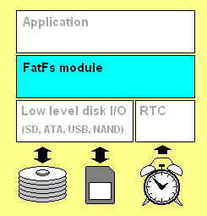
FatFs
http://elm-chan.org/fsw/ff/00index_e.html

Slide 14
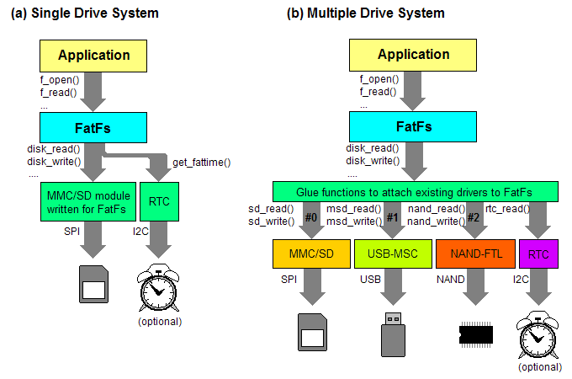
FatFs

Slide 15
FatFs
Function | Required when:
disk_initialize disk_status disk_read | Always
disk_write get_fattime disk_ioctl (CTRL_SYNC) | _FS_READONLY == 0
disk_ioctl (GET_SECTOR_COUNT) disk_ioctl (GET_BLOCK_SIZE) | _USE_MKFS == 1
disk_ioctl (GET_SECTOR_SIZE) | _MAX_SS != _MIN_SS
disk_ioctl (CTRL_ERASE_SECTOR) | _USE_ERASE == 1

Slide 16
What About mixed File Systems?
File System | API calls
FatFs | f_open(FIL *fp, const char *name, BYTE mode) f_close(FIL *fp) f_read(FIL* fp, void *data, UINT btr, UINT*br) f_write(FIL* fp, const void *data, UINT btw, UINT*bw)
UFFS | int uffs_open(const char *name, int oflag) int uffs_close(int fd) int uffs_read(int fd, void *data, int len) int uffs_write(int fd, const void *data, int len)
POSIX – Portable Operating System Interface

Slide 17
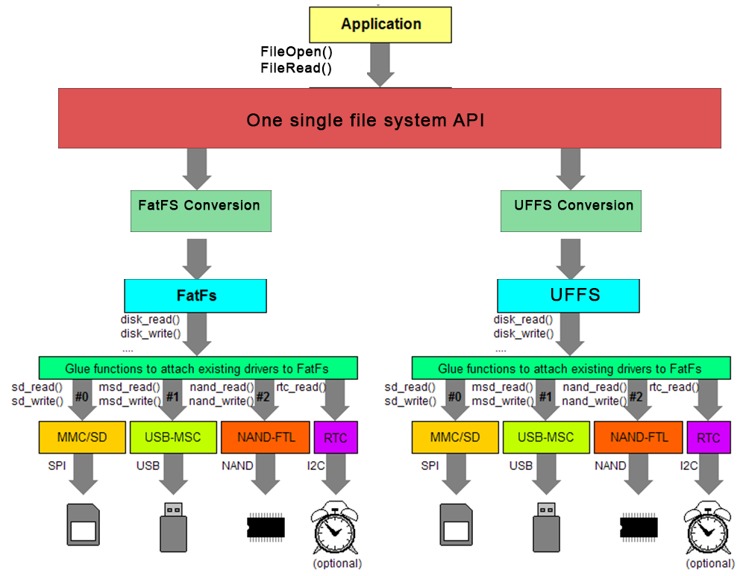

Slide 18
Usage
if (GpioIsSet(GPIO_PIN_SD_DETECT)) return;
SdInit();
if (!FileDevIsMounted(FDISK_SD)) return;
FFILE fil = FileOpen(SD_TEST_FILE, FOPEN_WRITE_PLUS);
if (!fil) return;
if (FilePuts(fil, SD_TEST_STR) > 0)
{
char readBuf[64];
FileSeek(fil, 0, FSEEK_SET);
if (FileGets(fil, readBuf, sizeof(readBuf)) != NULL)
{
if (strcmp(readBuf, SD_TEST_STR) == STR_CMP_MATCH)
{ // yay! }
} }
FileClose(fil);

Slide 19
Usage
int res;
FFIND find;
if (FileFindFirst(FILE_SD "*.*", true, &find) == FERR_NONE)
{
do{
LcdClear(); LcdPuts(find.fileName); LcdUpdate();
do{} while (!ButtonIsPressed(BTN_L));
TimerWaitXMs(25);
do{} while (ButtonIsPressed(BTN_L));
TimerWaitXMs(25);
res = FileFindNext(&find);
} while ((res == FERR_NONE) && (find.foundType != FFIND_TYPE_DONE));
}
// FileRemove(FILE_SD "*.txt");

Slide 20
You’re Turn!
https://xp-dev.com/svn/MPG/SAM3U/MPGL1/Demo/trunk
PC-Lint
demo.c

